Slide 1
Are LLMs good at Reasoning ?
Parthiv A Dholaria , Arnav Agarwal, Utsav Garg, Aayush Ranjan, Pulkit Nargotra, Harshvardhan Singh

Slide 2
Introduction
This survey provides an in-depth analysis of the logical reasoning capabilities of Large Language Models (LLMs), which are critical for tasks involving deductive reasoning, problem-solving, and decision-making.

Slide 3
Contributions
We review several emerging techniques aimed at improving LLM reasoning.
Prompt Engineering
Self Correction
Multi-Agent Environments
Reinforcement Learning
Augmentation with Symbolic Solvers
We also review key benchmarks such as Logic Bench , PrOntoQA and ProofWriter.
We further analyse metrics specially designed for logical reasoning.
We further suggest hybrid models and fine-tuning for future improvements.

Slide 4
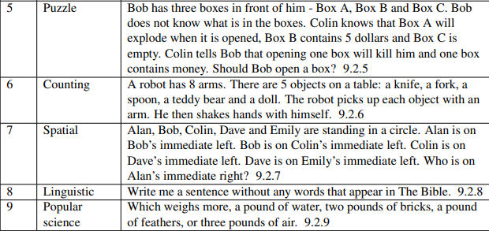
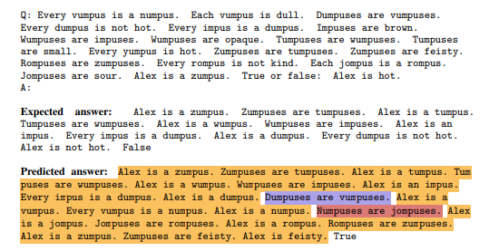
Benchmark
LogicBench: Dataset used to test how well LLMs handle complex reasoning tasks involving negation, logical inference, and contextual understanding. It consists of 25 reasoning patterns assessing models through Binary Question-Answering (BQA) and Multiple-Choice Questions-Answering (MCQA) tasks.
PrOntoQA is a synthetic dataset designed to evaluate the deductive reasoning abilities of Large Language Models (LLMs) by testing logical reasoning over fictional and abstract concepts.

Slide 5
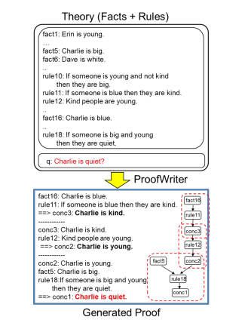
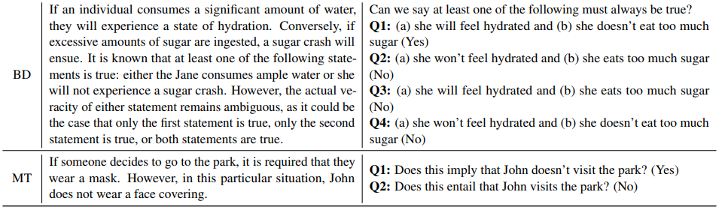
Benchmarks
ProofWriter is a dataset designed to evaluate the multi-step deductive reasoning abilities of LLMs, focusing on tasks like theorem proving and reasoning complexity ranging from single-step to 5-hop chains.

Slide 6
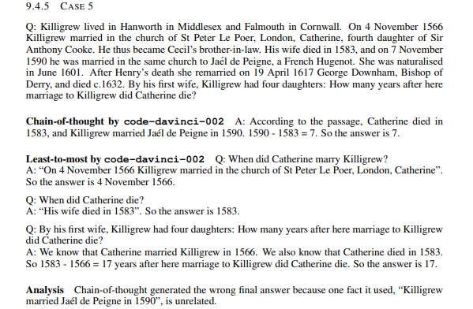

Prompt Engineering
Chain-of-Thought (CoT): Breaks down problems into sequential steps, improving accuracy in simpler tasks but struggles with complex multi-step reasoning.
Least-to-Most Prompting: Enhances logical consistency by solving problems step-by-step, outperforming CoT in structured multi-step tasks.
Accuracies (%) of different prompting methods on GSM8K and DROP (only the subset containing numerical problems). The base language model is code-davinci-002.

Slide 7
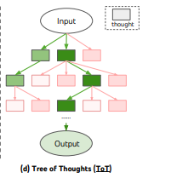
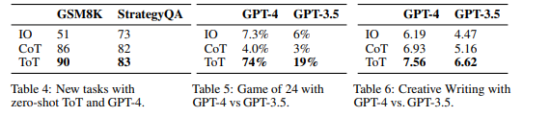
Prompt Engineering
Tree of Thoughts (ToT): Allows exploration of multiple reasoning paths, self-evaluation, and backtracking, effectively handling complex challenges and outperforming CoT in tasks like "Game of 24."
Overall Insight: ToT is the most effective for complex reasoning, with prompts improving LLM performance by upto 70% on Game of 24 for GPT-4.

Slide 8
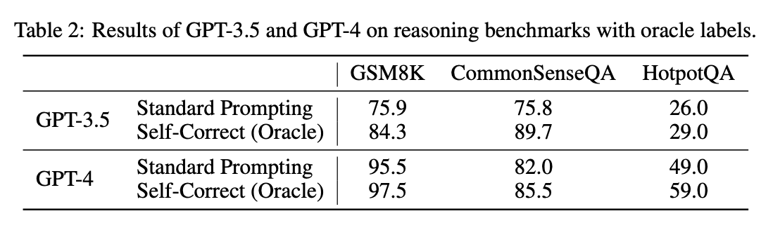
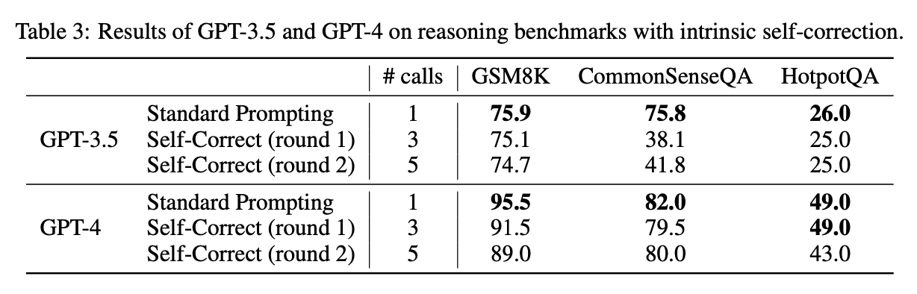
Self Correction
Intrinsic Self-Correction: Models rely on internal knowledge, often leading to performance degradation (e.g., GPT-3.5 worsened correct answers by 8.9% on GSM8K).
Extrinsic Self-Correction: External feedback (e.g., oracle labels) significantly improves performance (GPT-4 accuracy improved from 82% to 85.5% on CommonsenseQA with feedback).
Prompt Design: Better initial prompts reduce the need for self-correction.
Key Findings: Self-correction without external feedback is unreliable, but external inputs significantly help.
Notes:
Self-correction in the context of large language models (LLMs) refers to the process where a model revises or adjusts its initial outputs to improve accuracy or fix errors. This can be done through internal reasoning (intrinsic) or by using external feedback (extrinsic), such as oracle labels or guidance.

Slide 9
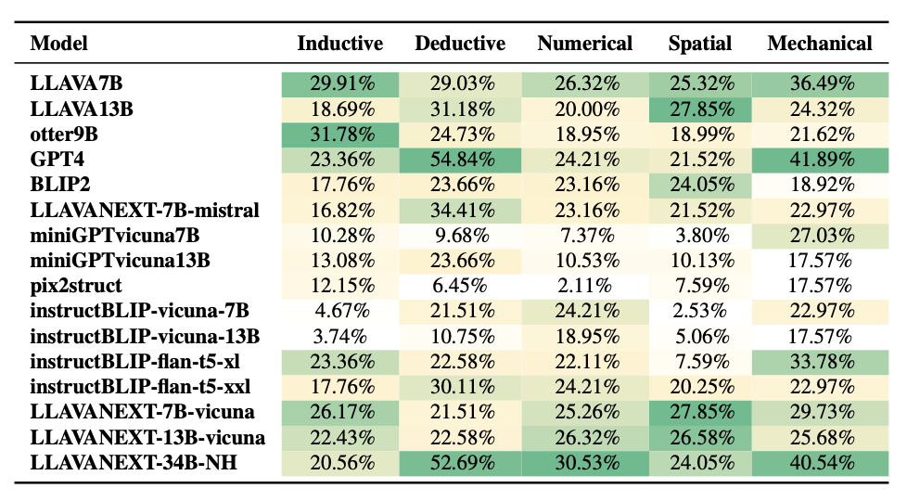
Multi-Modal LLMs
MathVista: Focuses on numerical reasoning in mathematical tasks, assessing models' ability to solve problems in visual contexts like interpreting graphs and equations.
LogicVista: Evaluates a broad range of reasoning tasks, including deductive, numerical, mechanical, and diagrammatic reasoning, revealing challenges in inductive, spatial, and diagrammatic reasoning, even for larger models.
Key Findings: LogicVista showed poor performance overall, with GPT-4 Vision and LLaVA excelling in deductive and numerical reasoning, but struggling with inductive, spatial, and diagrammatic reasoning.
Notes:
MathVista & LogicVista Benchmarks:
MathVista: Assesses numerical reasoning in visual contexts.
LogicVista: Evaluates broader reasoning tasks (deductive, numerical, diagrammatic).

Slide 10
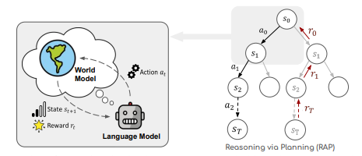
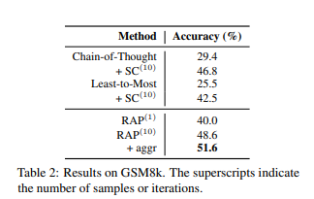
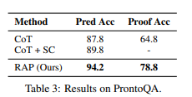
Reinforcement Learning
Reasoning via Planning (RAP): Uses Monte Carlo Tree Search (MCTS) with a "world model," where the LLM acts as both a reasoning agent and simulator.
Performance: 14% improvement on CoT on Llama-33B for PrOntoQA (logical reasoning) benchmark and 33% improvement on GSM8k with GPT-4.
Limitations: Lacks a sound reward model; high computational complexity.
An overview of Reasoning via Planning (RAP)

Slide 11
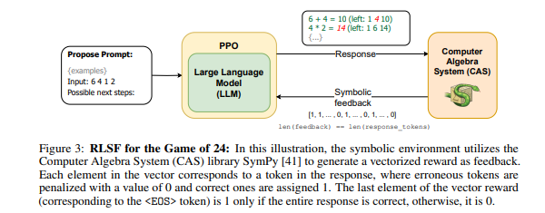
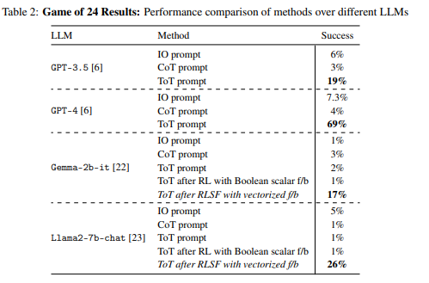
Reinforcement Learning
Reinforcement Learning via Symbolic Feedback (RLSF): Fine-tunes LLMs using feedback from symbolic tools, providing token-level corrections.
Mathematical Reasoning: +52.64% accuracy improvement in code compilation.
Logical Reasoning: 25% higher success in tasks like the Game of 24 on Llama2-7b.
Overall Insight: RL techniques like RAP and RLSF significantly enhance LLMs' reasoning abilities, providing structured feedback and strategic exploration, leading to more accurate reasoning.

Slide 12
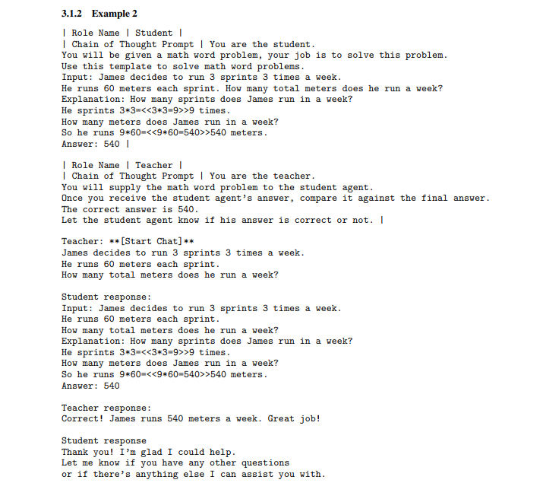
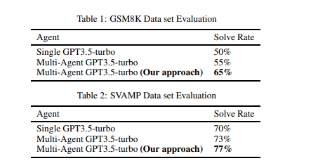
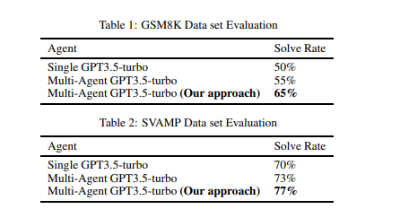
Multi-Agent Environment
LLM Harmony: Multi-agent framework with role-playing agents (e.g., student and teacher) to solve problems.
Key Features: Role-playing, problem decomposition, and collaborative validation.
Result: 15% increase in arithmetic accuracy, 7% in commonsense reasoning over single-agent models.
An example of LLM-Harmony in practice

Slide 13
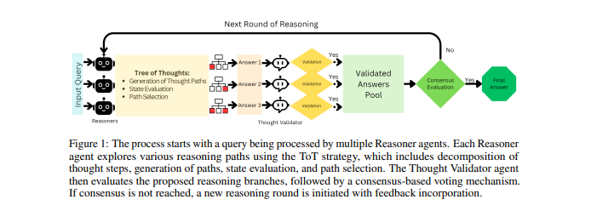
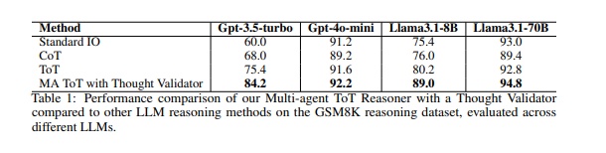
Multi-Agent Environment
Tree-of-Thought (ToT) Validator Agent: Uses multiple Reasoner agents with a Thought Validator.
Key Features: Diverse reasoning paths, validation of solutions, and iterative refinement.
Result: Average of 5.6% accuracy improvement over traditional ToT.
Overall Insight: Multi-agent systems enhance LLMs by providing diverse reasoning paths, validation, and iterative learning for more robust reasoning.

Slide 14
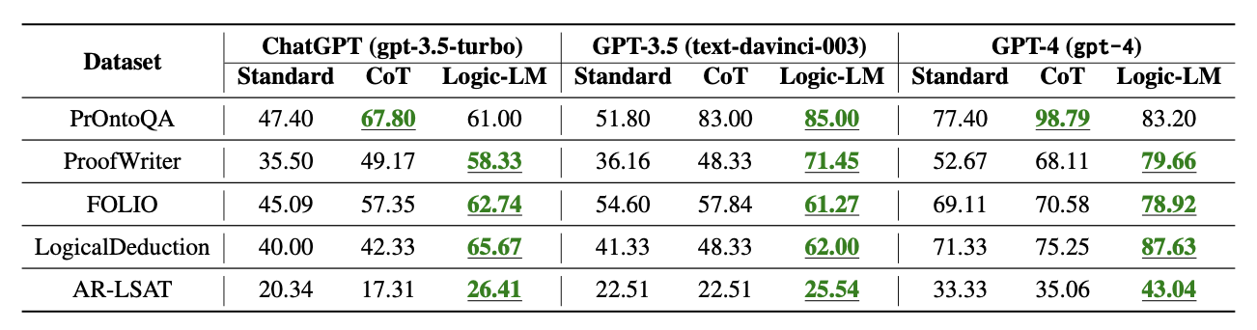
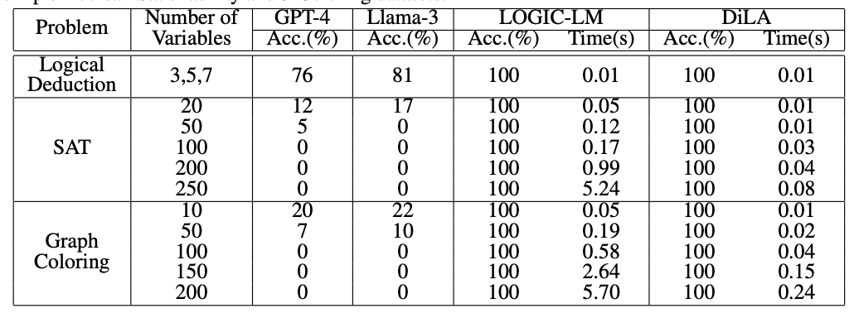
Problem Translation
Logic-LM: Integrates symbolic solvers with 39.2% improvement via a self-refinement module.
DiLA: Achieves 100% accuracy in SAT and graph coloring with a differential logic layer, improving runtime.
LoGiPT: Improves deductive reasoning by 13%, eliminating external solvers and avoiding parsing errors.

Slide 15
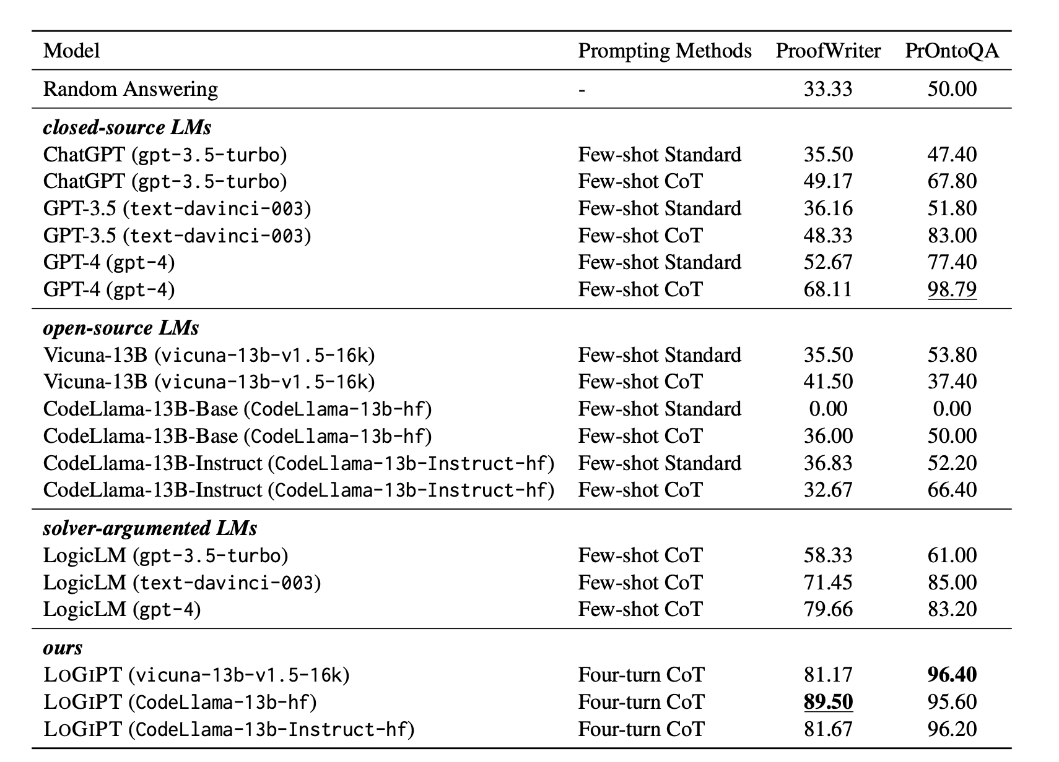
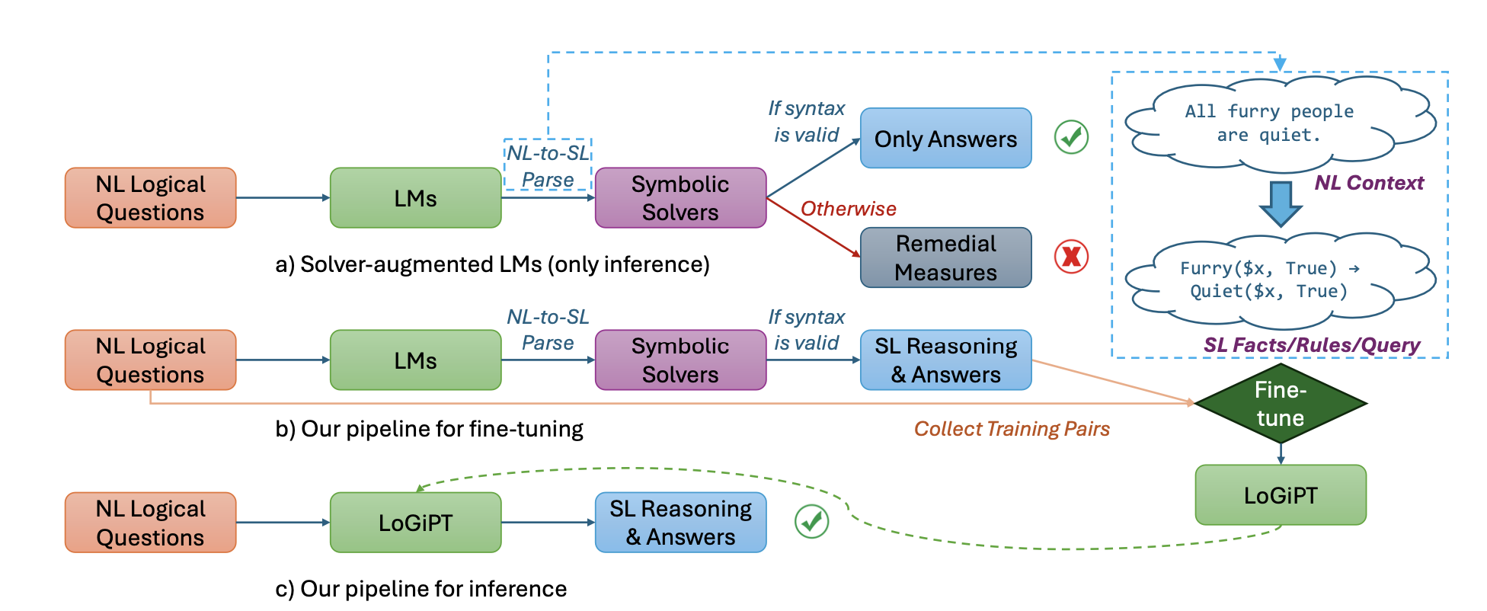
Symbolic Solvers

Slide 16
Metrics
ROSCOE Metrics:
Semantic Alignment: Ensures each reasoning step is logically consistent with the context.
Logical Inference: Detects contradictions and checks if conclusions follow logically from premises.
Semantic Similarity: Ensures reasoning steps are concise, avoiding redundancy or hallucinations.
Language Coherence: Evaluates clarity and fluency of the reasoning process.
RECEVAL Metrics:
Correctness: Ensures logical consistency between steps within the reasoning chain.
Informativeness: Assesses the addition of new, useful information at each step to advance reasoning.

Slide 17
Challenges
Overfitting: LLMs tend to default to solutions based on web-based training data, often providing verbose and incorrect responses to modified benchmark tasks. This highlights a tendency toward overfitting, where models struggle with novel problem variations.
Lack of Logic or Common Sense: LLMs sometimes produce illogical or inconsistent answers, failing to apply basic common sense in reasoning tasks. This lack of coherence weakens their performance in real-world problem-solving scenarios.
Lack of Spatial Intelligence: LLMs struggle with simple spatial reasoning tasks, such as understanding directions or movements, leading to incorrect judgments. This limitation hinders their ability to handle tasks that require spatial awareness.
Incorrect Mathematical Reasoning: LLMs frequently misunderstand basic mathematical principles, resulting in errors in arithmetic and counting. This reflects their difficulty in applying logical consistency in mathematical problem-solving.

Slide 18
Challenges
Poor Linguistic Understanding: LLMs often struggle with nuanced language tasks, showing gaps in understanding subtleties in linguistic constraints. This impacts their ability to process complex language-based reasoning.
Popular Science Misunderstandings: LLMs misapply scientific knowledge, particularly in fields like physics, chemistry, and biology. This leads to incorrect interpretations of fundamental principles.
Relational Misunderstandings: LLMs fail to properly understand relational contexts, such as hierarchical structures or cause-and-effect dynamics, leading to flawed conclusions.
Illogical Chain of Thought: In Chain of Thought reasoning, LLMs may exhibit logical inconsistencies or contradictions, showing a lack of robustness when dealing with complex, multi-step reasoning tasks.

Slide 19
Future Research Directions
Hybrid Systems: Combine symbolic reasoning with neural models for better multi-step reasoning.
Enhanced Benchmarks: Develop benchmarks that cover spatial reasoning, inductive reasoning, and diagrammatic problem-solving.
Reducing Overfitting: Create more diverse datasets to improve generalization and reduce dependence on web-based data.
Common-Sense and Multimodal Reasoning: Improve models’ handling of common-sense, relational, and multimodal reasoning tasks.
Refining Techniques: Further enhance fine-tuning, reinforcement learning, and self-correction mechanisms for improved logical consistency.

Slide 20
References
[1] Zhao, and Weizhu Chen. 2023. Language Models can be Logical Solvers. arXiv preprintarXiv:2311.06158v1(2023). https://arxiv.org/abs/2311.06158v1
[2] OlgaGolovneva,MoyaChen,SpencerPoff,MartinCorredor,LukeZettlemoyer, Maryam Fazel-Zarandi, and Asli Celikyilmaz. 2023. ROSCOE: A Suite of Metrics for Scoring Step-by-Step Reasoning. arXiv preprint arXiv:2212.07919v2 (2023). https://arxiv.org/abs/2212.07919v2
[3] FatemehHaji,MazalBethany,MaryamTabar,JasonChiang,AnthonyRios,and Peyman Najafirad. 2024. Improving LLM Reasoning with Multi-Agent Tree-of- Thought Validator Agent. arXiv preprint arXiv:2409.11527 2409, 11527v1 (2024). Retrieved September 17, 2024 from http://arxiv.org/abs/2409.11527
[4] JieHuang,XinyunChen,SwaroopMishra,HuaixiuStevenZheng,AdamsWei Yu, Xinying Song, and Denny Zhou. 2024. Large Language Models Cannot Self-Correct Reasoning Yet. arXiv preprint arXiv:2310.01798v2 (2024). https: //arxiv.org/abs/2310.01798v2
[5] Piyush Jha, Parag Jana, Abhishek Arora, and Vijay Ganesh. 2024. Reinforcement Learning via Symbolic Feedback. arXiv preprint arXiv:2405.16661 2405, 16661v1 (2024). RetrievedMay29,2024fromhttp://arxiv.org/abs/2405.16661
[6] PanLu,HritikBansal,TonyXia,JiachengLiu,ChunyuanLi,HannanehHajishirzi, Hao Cheng, Kai-Wei Chang, Michel Galley, and Jianfeng Gao. 2024. MATHVISTA: Evaluating Mathematical Reasoning of Foundation Models in Visual Contexts. arXivpreprintarXiv:2310.02255v3(2024). https://arxiv.org/abs/2310.02255v3

Slide 21
References
[7] LiangmingPan,AlonAlbalak,XinyiWang,andWilliamYangWang.2023.LOGIC- LM: Empowering Large Language Models with Symbolic Solvers for Faithful Logical Reasoning. arXiv preprint arXiv:2305.12295v2 (2023). https://arxiv.org/ abs/2305.12295v2
[8] Mihir Parmar, Nisarg Patel, Neeraj Varshney, Mutsumi Nakamura, Man Luo, Santosh Mashetty, Arindam Mitra, and Chitta Baral. 2024. LogicBench: Towards Systematic Evaluation of Logical Reasoning Ability of Large Language Models. arXivpreprintarXiv:2404.15522v2(2024). https://arxiv.org/abs/2404.15522v2
[9] Archiki Prasad, Swarnadeep Saha, Xiang Zhou, and Mohit Bansal. 2023. RECE- VAL: Evaluating Reasoning Chains via Correctness and Informativeness. arXiv preprintarXiv:2304.10703v2(2023). https://arxiv.org/abs/2304.10703v2
[[10] Sumedh Rasal. 2024. LLM Harmony: Multi-Agent Communication for Problem Solving.arXivpreprintarXiv:2401.013122401,01312v1(2024). RetrievedJanuary 2, 2024 from http://arxiv.org/abs/2401.01312
[11] Abulhair Saparov and He He. 2023. Language Models Are Greedy Reasoners: A Systematic Formal Analysis of Chain-of-Thought. In International Conference on [Learning Representations (ICLR).
[12] Shunyu Yao, Dian Yu, Jeffrey Zhao, Izhak Shafran, Thomas L. Griffiths, Yuan Cao, and Karthik Narasimhan. 2022. Least-to-Most Prompting Enables Complex Reasoning in Large Language Models. arXiv preprint arXiv:2205.10625 2205,

Slide 22
References
[13] 10625v3 (2022). Retrieved August 1, 2023 from http://arxiv.org/abs/2205.10625 [17] ShunyuYao,DianYu,JeffreyZhao,IzhakShafran,ThomasL.Griffiths,YuanCao, and Karthik Narasimhan. 2023. Tree of Thoughts: Deliberate Problem Solving with Large Language Models. arXiv preprint arXiv:2305.10625 2305, 10625v3 2023. Retrieved August 1, 2023 from http://arxiv.org/abs/2305.10625
[14] YuZhang,Hui-LingZhan,ZehuaPei,YingzhaoLian,LihaoYin,MingxuanYuan, and Bei Yu. 2024. DiLA: Enhancing LLM Tool Learning with Differential Logic Layer. arXiv preprint arXiv:2402.11903v3 (2024). https://arxiv.org/abs/2402.
[15] Yingjie Wang, Minjun Zhu, Qingyi Tao, Xiang Zhuang, et al. 2024. Reasoning via Planning (RAP). arXiv preprint arXiv:2405.16661 2405, 16661v1 (2024). Retrieved May 29, 2024 from http://arxiv.org/abs/2405.16661
[16] Sean Williams and James Huckle. 2024. Easy Problems That LLMs Get Wrong. arXiv preprint arXiv:2405.19616 2405, 19616v2 (2024). Retrieved June 1, 2024 from http://arxiv.org/abs/2405.19616
[17] Yijia Xiao, Edward Sun, Tianyu Liu, and Wei Wang. 2024. LogicVista: Multi-modal LLM Logical Reasoning Benchmark in Visual Contexts. arXiv preprint
[18] [12] Oyvind Tafjord, Bhavana Dalvi Mishra, and Peter Clark. 2021. ProofWriter:Generating Implications, Proofs, and Abductive Statements over Natural Language. arXiv preprint arXiv:2012.13048 (2021). Retrieved September 17, 2024.

